Slide 1


RobotWare for SpaceClaim
SpaceClaim automation without the pain of code
by
EllieWare
(Trevor D'Arcy-Evans)

Slide 2
Current Macro Environments
Record/replay user actions
  Unreliable
  Difficult to reuse actions
Scripting
  Users are not programmers
  Requires understanding of object model
  Steep learning curve

Slide 3
RobotWare for SpaceClaim
(what it is)
Small, general purpose steps
Chained together to form a macro
Each step individually configurable
Point and click interface
Code free environment

Slide 4
RobotWare for SpaceClaim
(what it is not)
General purpose scripting environment
Complex flow control
Complex decision making

Slide 5
RobotWare for SpaceClaim
Fully integrated into SpaceClaim
Adds SpaceClaim specific steps
Many other general purpose steps
Automate repetitive tasks

Slide 6
Features
Save, load and edit sequences of steps
Simple, intuitive interface
Parameterized macros
Call other macros
Extensible via RobotWare API

Slide 7
SpaceClaim Specific Steps
Open/close/save SpaceClaim file
Import/export geometry
Export to raster or PDF file
View manipulation

Slide 8
General Purpose Steps
Windows file/directory manipulation
FTP file/directory manipulation
Play a sound file or Windows system sound
Windows process manipulation
Zip file manipulation

Slide 9
RobotWare for SpaceClaim
Demonstration
Open a native SpaceClaim file
Export to Parasolid format
Import Parasolid file
(and other SpaceClaim specific operations!)

Slide 10
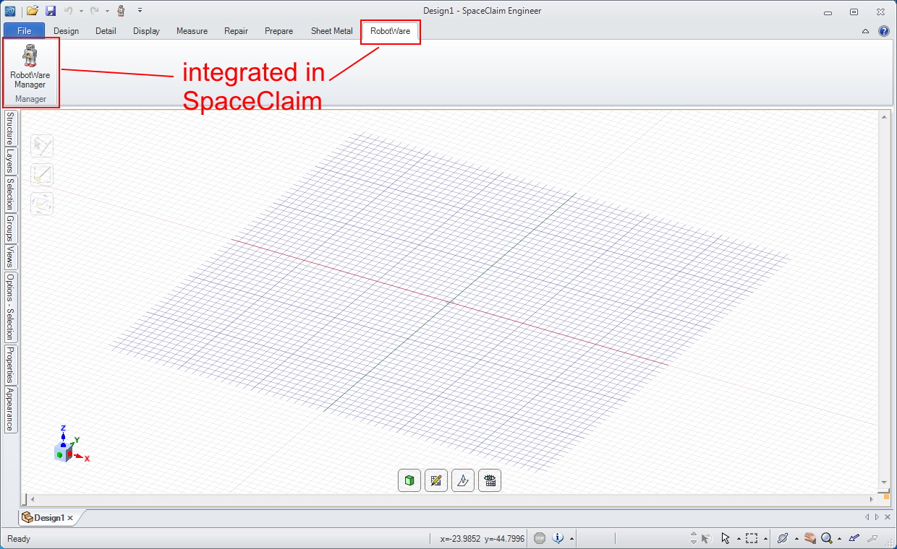
Fully integrated into SpaceClaim
(as a tab in the ribbon)

Slide 11
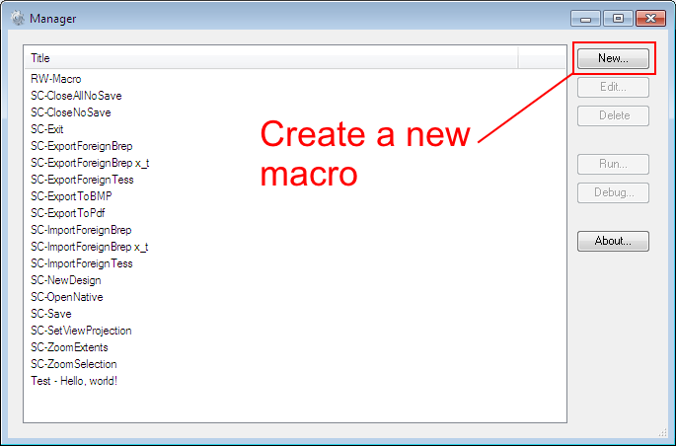
Macro Manager
(macros available for reuse)

Slide 12
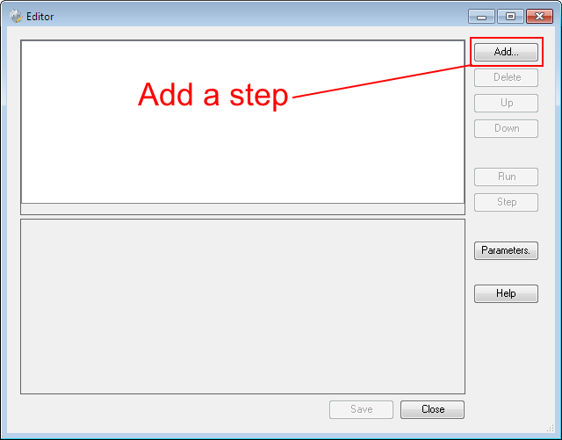
Macro Editor
(add, delete and reorder steps)

Slide 13
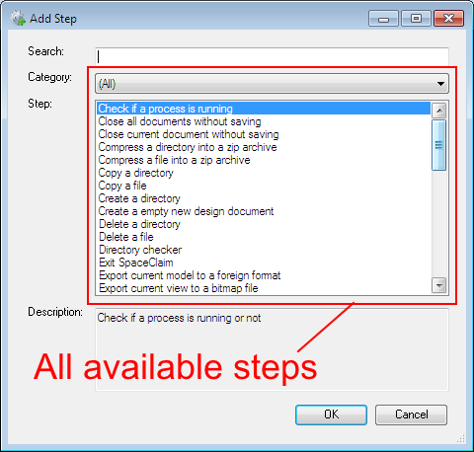
Select a step
(everything RobotWare can do)

Slide 14
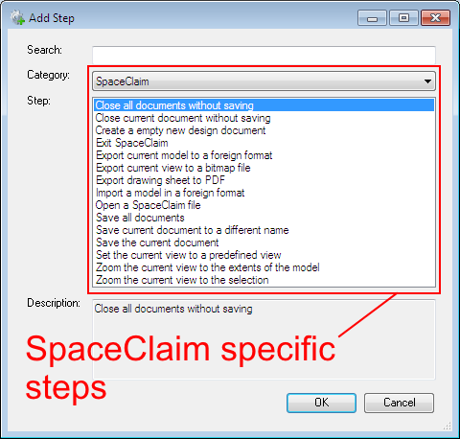
Select a SpaceClaim step
(filter and/or search by keyword)

Slide 15
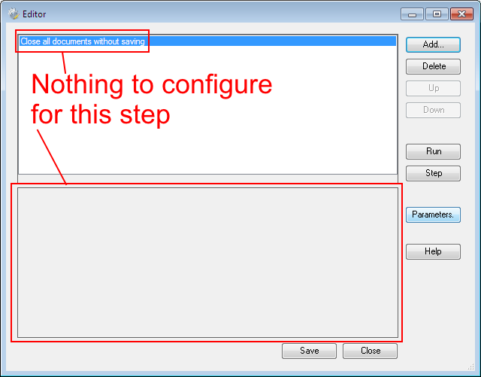
Configure the step
(close all documents without saving)

Slide 16
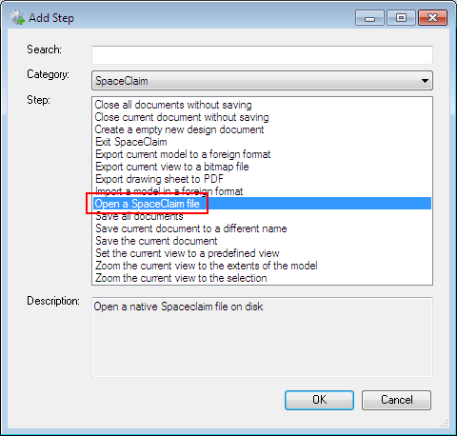
Add another step
(open a native SpaceClaim file)

Slide 17
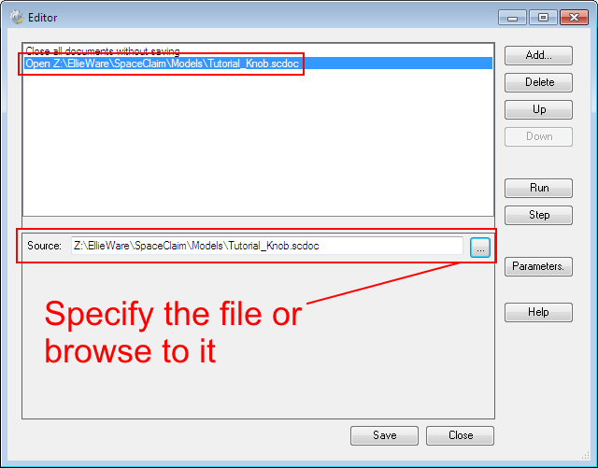
Configure the step
(select or specify file)

Slide 18
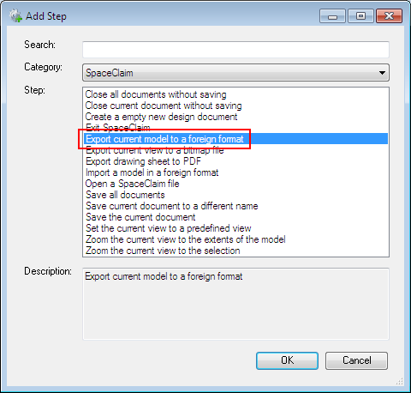
Add another step
(export to a different format)

Slide 19
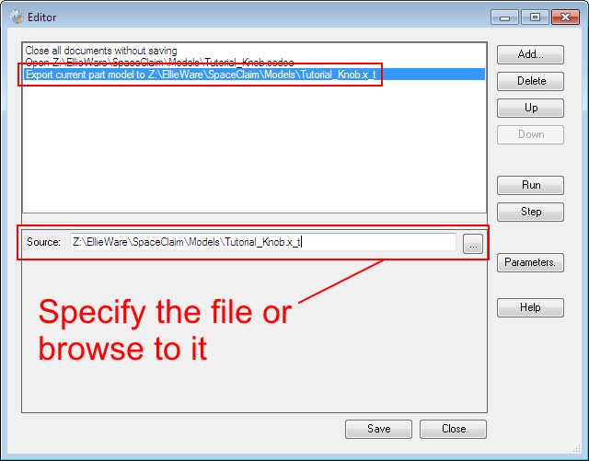
Configure the step
(format is deduced from extension)

Slide 20
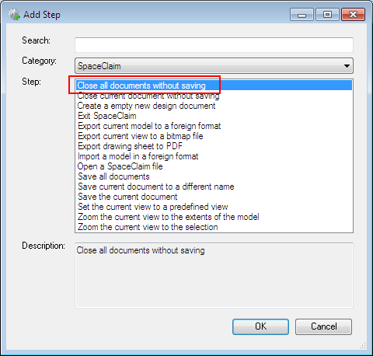
Add another step
(close all documents without saving)

Slide 21
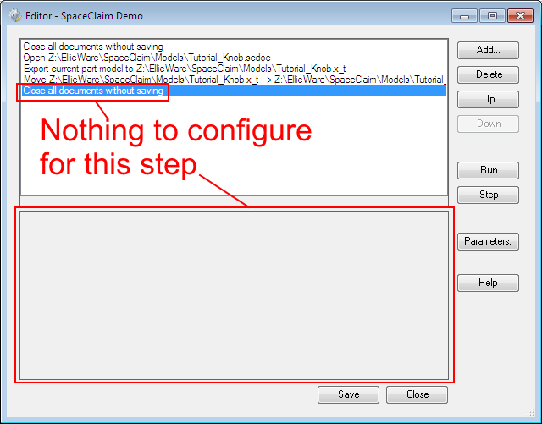
Configure the step
(no configuration required)

Slide 22
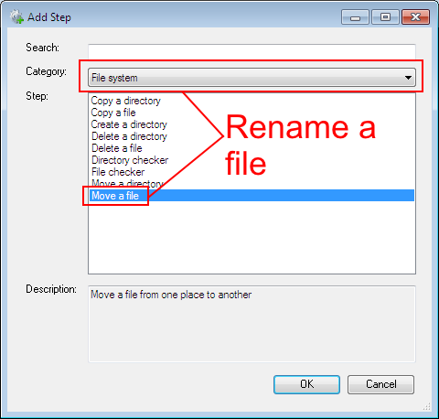
Add another step
(rename our exported file)

Slide 23
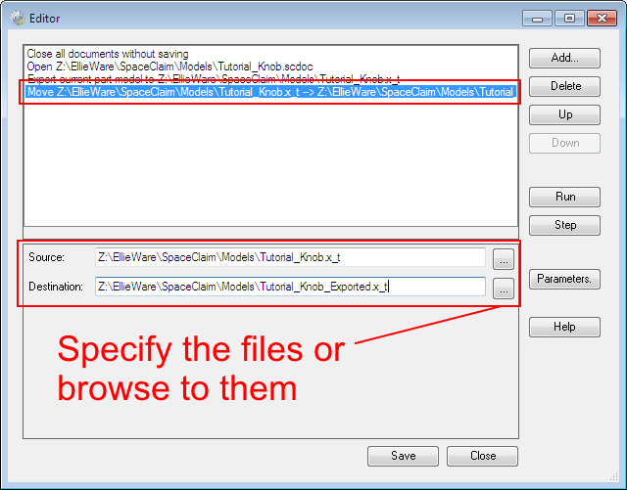
Configure the step
(specify the new name)

Slide 24

Add another step
(close all documents)

Slide 25
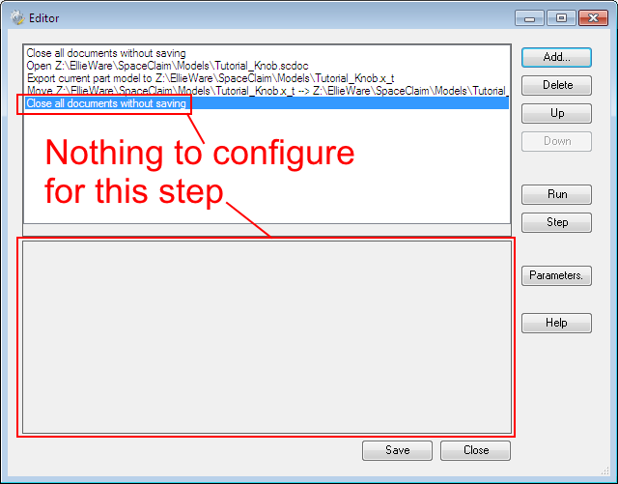
Configure the step
(no configuration required)

Slide 26
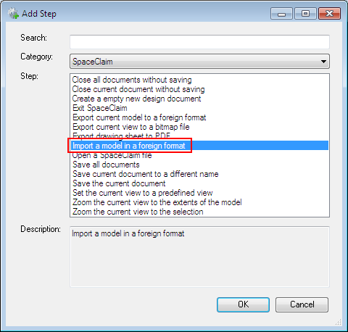
Add another step
(import our exported file)

Slide 27
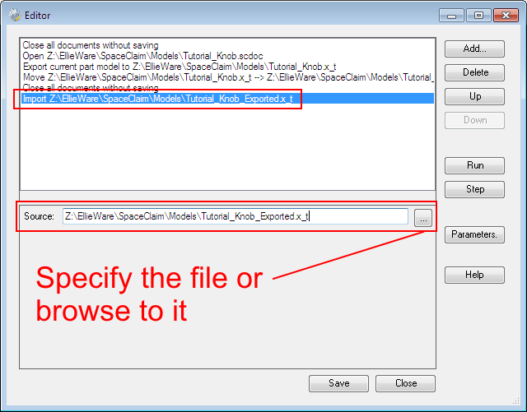
Configure the step
(specify the new name)

Slide 28
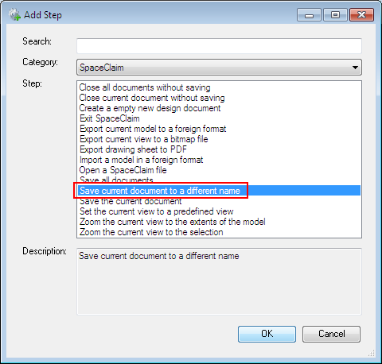
Add another step
(save as SpaceClaim file)

Slide 29
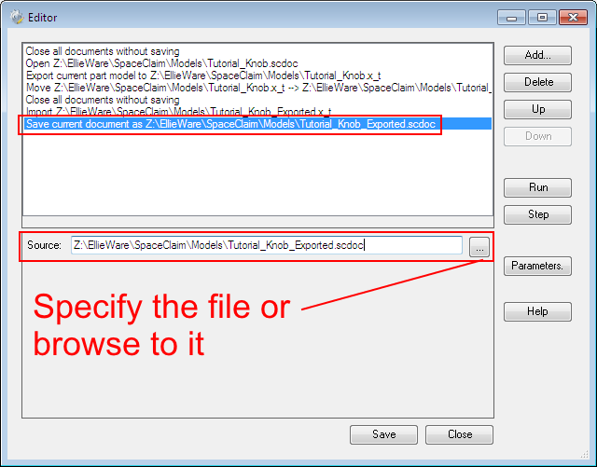
Configure the step
(specify the new name)

Slide 30
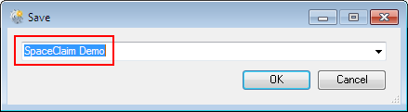
Save the sequence of steps
(for future reuse)

Slide 31
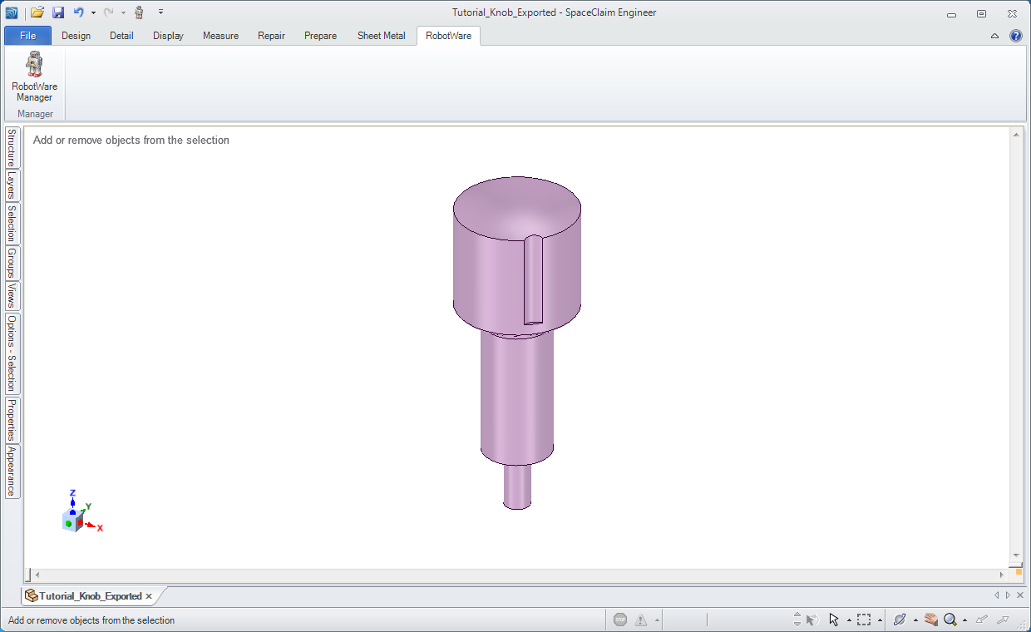
Run the sequence
(admire the results!)

Slide 32
User Features and Benefits
Save time
  Automate repetitive tasks
  Reuse macros
Easy learning curve
  Simple interface and configuration
  No code to write!
Integrated with SpaceClaim
  Stay in SpaceClaim environment
  SpaceClaim specific steps

Slide 33
Product Roadmap
Batch import/export geometry
Repair/simplify geometry
Better support for batch operations
Third party integration
More SpaceClaim specific steps!

Slide 34
Questions and Answers

